Slide 1

Von Neumann Stability Analysis
Let’s consider a linear hyperbolic scalar conservation law
$$\frac{∂q(x,t)}{∂t}+\frac{∂f(q)}{∂x}=0$$
Let $ℋ$ be a discrete flux scheme which approximate flux differential term.
For $j th$ cell
$$\frac{dq_{h,j}}{dt}+ℋ\left(q_{h,j−1},q_{h,j},q_{h,j+1};j\right)=0$$
Here $ℋ$ is a linear function of approximate value of flux differential for $j th$ cell.
Decomposed approximated numerical solution $q_{h}$ to exact solution $q$ and numerical error $ε$
$$q_{h,j}\left(t\right)=q_{j}\left(x,t\right)−ε_{j}(x,t)$$
Substitute into Eq.(1)
$$\frac{∂}{∂t}\left[q_{j}−ε_{j}\right]+ℋ\left(q_{j−1}−ε_{j−1},q_{j}−ε_{j},q_{j+1}−ε_{j+1};j\right)=0$$
$${(∙)}_{j−1}≡\left(∙\right)\left(x−∆x,t\right)$$
$${(∙)}_{j}≡(∙)(x,t)$$
$${(∙)}_{j+1}≡(∙)(x+∆x,t)$$
(1)

Slide 2

Von Neumann Stability Analysis
By linearity
$$\frac{∂q_{j}}{∂t}+ℋ\left(q_{j−1},q_{j},q_{j+1};j\right)+\frac{∂ε_{j}}{∂t}+ℋ\left(ε_{j−1},ε_{j},ε_{j+1};j\right)=0$$
We assume that $ℋ$ well approximate the flux differential value.
Then $q$ must satisfy semi-discrete equation
$$\frac{∂q_{j}}{∂t}+ℋ\left(q_{j−1},q_{j},q_{j+1};j\right)=0$$
$$⇒\frac{∂ε_{j}}{∂t}+ℋ\left(ε_{j−1},ε_{j},ε_{j+1};j\right)=0$$
This means that the numerical error and the exact numerical solution both possess the same growth property in time.
For stable system, $ε$ should be prevented from growing without bound with the passage of time.
To analyze $ε$, let’s use variable separation method
$$ε_{j}(x,t)=X\left(x\right)T(t)$$
And assume that $X\left(x\right)$ is a continuous and periodic function which have a period $λ$.
(2)
(3)

Slide 3

Von Neumann Stability Analysis
Then we can use Fourier series to express $X\left(x\right)$
$$X\left(x\right)=\sum_{m=−∞}^{∞}{𝒳_{m}^{ }e^{imk_{0}x}} where 𝒳_{m}^{ }=\frac{1}{λ}\int_{−\frac{λ}{2}}^{\frac{λ}{2}}{X\left(x\right)e^{−imk_{0}x}}dx ,k_{0}=\frac{2π}{λ}$$
Substitute into Eq. (3) and Simplify it using $E_{m}(t)$
$$ε(x,t)=\sum_{m=−∞}^{∞}{𝒳_{m}^{ }T(t)e^{imk_{0}x}}=\sum_{m=−∞}^{∞}{E_{m}(t)e^{imk_{0}x}} where E_{m}\left(t\right)≡𝒳_{m}T(t)$$
We look over meaning of $E_{m}(t)$. It can be interpreted as a amplitude of Error.
So for stable system, summation of $E_{m}(t)$ should not grow without bound with the passage of time.
$$\left|\frac{ε\left(x,t^{n+1}\right)}{ε\left(x,t^{n}\right)}\right|=\left|\frac{\sum_{m=−∞}^{∞}{E_{m}\left(t^{n+1}\right)}}{\sum_{m=−∞}^{∞}{E_{m}\left(t^{n}\right)}}\right|≤1$$
(4)

Slide 4
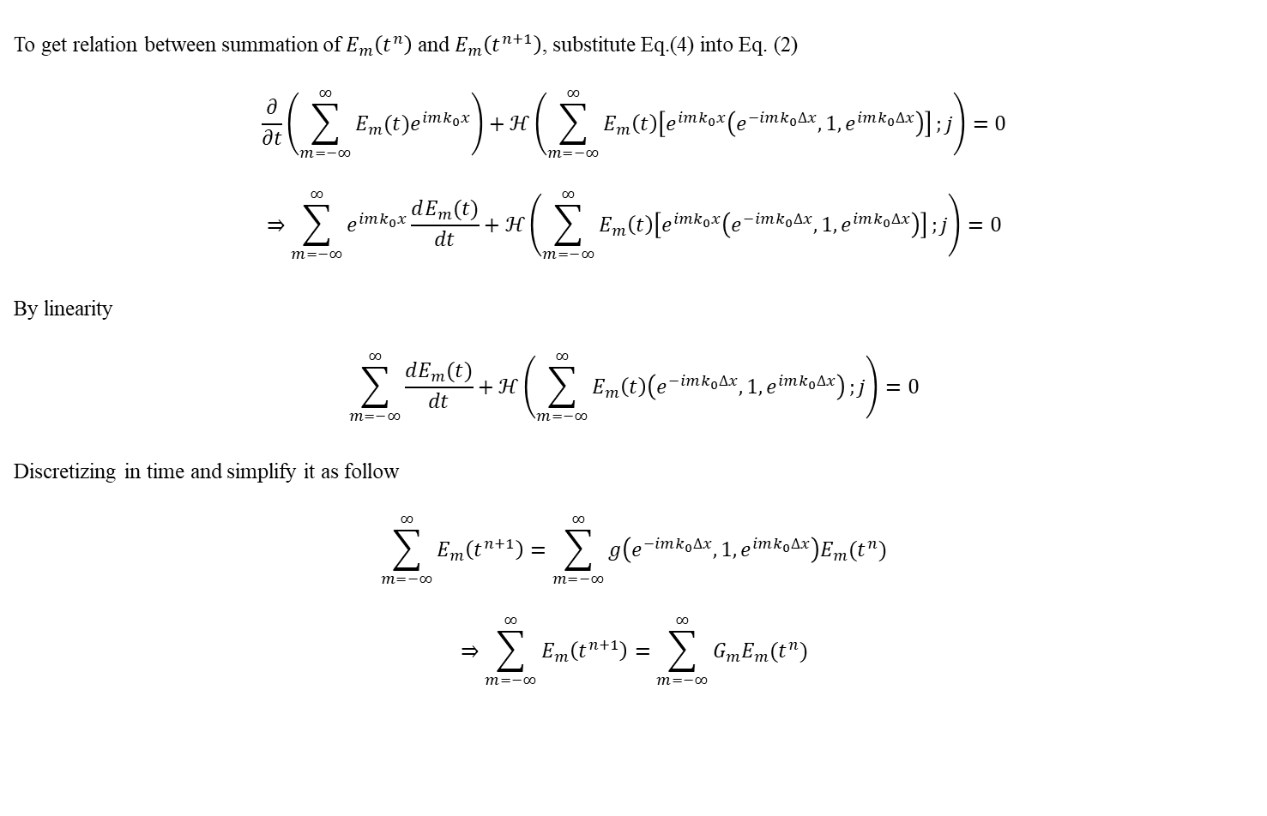
Von Neumann Stability Analysis
To get relation between summation of $E_{m}\left(t^{n}\right)$ and $E_{m}\left(t^{n+1}\right)$, substitute Eq.(4) into Eq. (2)
$$\frac{∂}{∂t}\left(\sum_{m=−∞}^{∞}{E_{m}(t)e^{imk_{0}x}}\right)+ℋ\left(\sum_{m=−∞}^{∞}{E_{m}\left(t\right)\left[e^{imk_{0}x}\left(e^{−imk_{0}∆x},1,e^{imk_{0}∆x}\right)\right]};j\right)=0$$
$$⇒\sum_{m=−∞}^{∞}{e^{imk_{0}x}}\frac{dE_{m}(t)}{dt}+ℋ\left(\sum_{m=−∞}^{∞}{E_{m}\left(t\right)\left[e^{imk_{0}x}\left(e^{−imk_{0}∆x},1,e^{imk_{0}∆x}\right)\right]};j\right)=0$$
By linearity
$$\sum_{m=−∞}^{∞}{\frac{dE_{m}(t)}{dt}}+ℋ\left(\sum_{m=−∞}^{∞}{E_{m}\left(t\right)\left(e^{−imk_{0}∆x},1,e^{imk_{0}∆x}\right)};j\right)=0$$
Discretizing in time and simplify it as follow
$$\sum_{m=−∞}^{∞}{E_{m}\left(t^{n+1}\right)}=\sum_{m=−∞}^{∞}{g\left(e^{−imk_{0}∆x},1,e^{imk_{0}∆x}\right)E_{m}(t^{n})}$$
$$⇒\sum_{m=−∞}^{∞}{E_{m}\left(t^{n+1}\right)}=\sum_{m=−∞}^{∞}{G_{m}E_{m}(t^{n})}$$
(5)

Slide 5

Von Neumann Stability Analysis
Let’s analyze ratio of sum of $E_{m}$
$$\lim_{M→∞}\left|\frac{E_{−M}\left(t^{n+1}\right)+…+E_{M}\left(t^{n+1}\right)}{E_{−M}\left(t^{n}\right)+…+E_{M}\left(t^{n}\right)}\right|$$
We define a set ${\left\{\left|G_{m}\right|\right\}}_{m=−∞,…,∞}$ and a constant $G_{max}$
$$G_{max}=\sup{\{\left|G_{m}\right|\}}$$
Then following inequality satisfy
$$\lim_{M→∞}\left|\frac{E_{−M}\left(t^{n+1}\right)+…+E_{M}\left(t^{n+1}\right)}{E_{−M}\left(t^{n}\right)+…+E_{M}\left(t^{n}\right)}\right|≤\lim_{M→∞}\frac{\left|E_{−M}\left(t^{n+1}\right)\right|+…+\left|E_{M}\left(t^{n+1}\right)\right|}{\left|E_{−M}\left(t^{n}\right)\right|+…+\left|E_{M}\left(t^{n}\right)\right|}=\lim_{M→∞}\frac{\left|G_{−M}\right|\left|E_{−M}\left(t^{n}\right)\right|+…+\left|G_{M}\right|\left|E_{M}\left(t^{n}\right)\right|}{\left|E_{−M}\left(t^{n}\right)\right|+…+\left|E_{M}\left(t^{n}\right)\right|}≤G_{max}$$
So for stable system
$$G_{max}≤1$$

